Slide 1
DMS 201 : Introduction to Management Module-II: Financial Management Dr. Parvati Neelakantan

Slide 2
PART 1: BUSINESS ENVIRONMENT Lecture 9: Introduction to Risk, Diversification, and Portfolio Selection

Slide 3
Topics Covered
The relationship between risk and return.
How to measure risk.
How diversification reduces risk.
Systematic risk is market risk.
Should companies diversify?
3

Slide 4
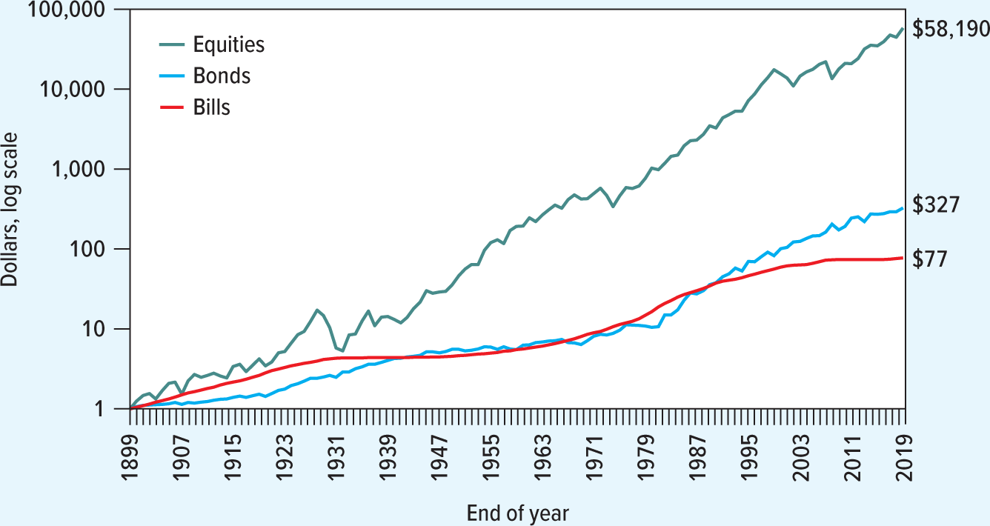
How an Investment of $1 at the End of 1899 Would Have Grown by the End of 2020
How an investment of $1 at the start of 1900 would have grown by the end of 2020, assuming reinvestment of all dividend and interest payments.
Source: E. Dimson, P. R. Marsh, and M. Staunton, Triumph of the Optimists: 101 Years of Global Investment Returns (Princeton, N J: Princeton University Press, 2002), with updates provided by the authors.
3

Slide 5
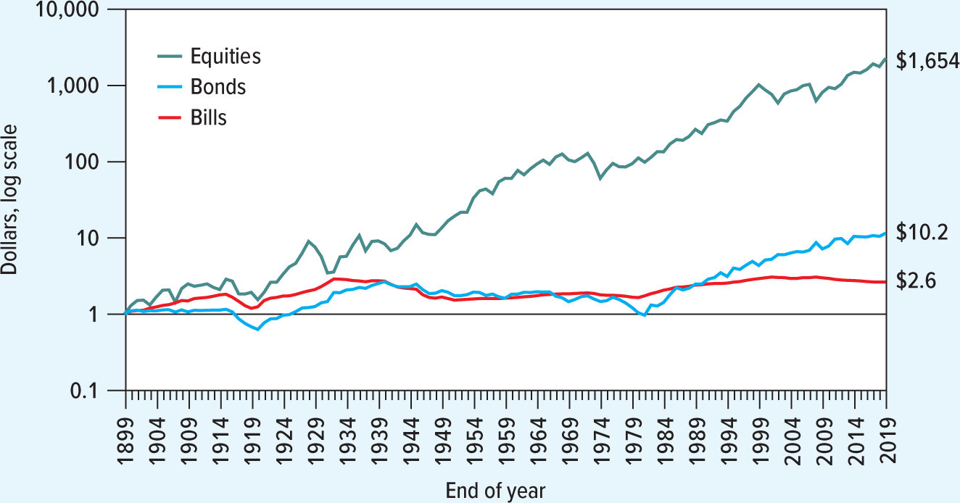
How an Investment of $1 at the End of 1899 Would Have Grown in Real Terms by the End of 2020
How an investment of $1 at the start of 1900 would have grown in real terms by the end of 2020, assuming reinvestment of all dividend and interest payments. Compare this plot with the previous Figure, and note how inflation has eroded the purchasing power of returns to investors.
The average rate of inflation over 121 years was only about 3%, but a comparison of the figures show the difference that “only 3%” inflation makes.
Source: E. Dimson, P. R. Marsh, and M. Staunton, Triumph of the Optimists: 101 Years of Global Investment Returns (Princeton, N J: Princeton University Press, 2002), with updates provided by the authors.
4

Slide 6
Average annual rates of return
U.S. Treasury bills, government bonds, and stocks, 1900–2020.
Average Annual Rate of Return
 | Nominal | Real | Average Risk Premium (Extra Return versus Treasury Bills)
Treasury bills | 3.7% | 0.9% | 0%
Government bonds | 5.4 | 2.6 | 1.7
Stocks | 11.5 | 8.5 | 7.8
Source: E. Dimson, P. R. Marsh, and M. Staunton, Triumph of the Optimists: 101 Years of Global Investment Returns (Princeton. N J: Princeton University Press. 2002), with updates provided by the authors.
An investment in long-term government bonds would have produced an average nominal return of 5.4%. By taking on the risk of stocks, investors earned a return of 11.5%, a risk premium of 11.5-3.7=7.8% over the return on Treasury bills. Average inflation reduced the real returns on these securities by about 3% a year.
* Treasury Bills are called Cash Management Bills in India
5

Slide 7
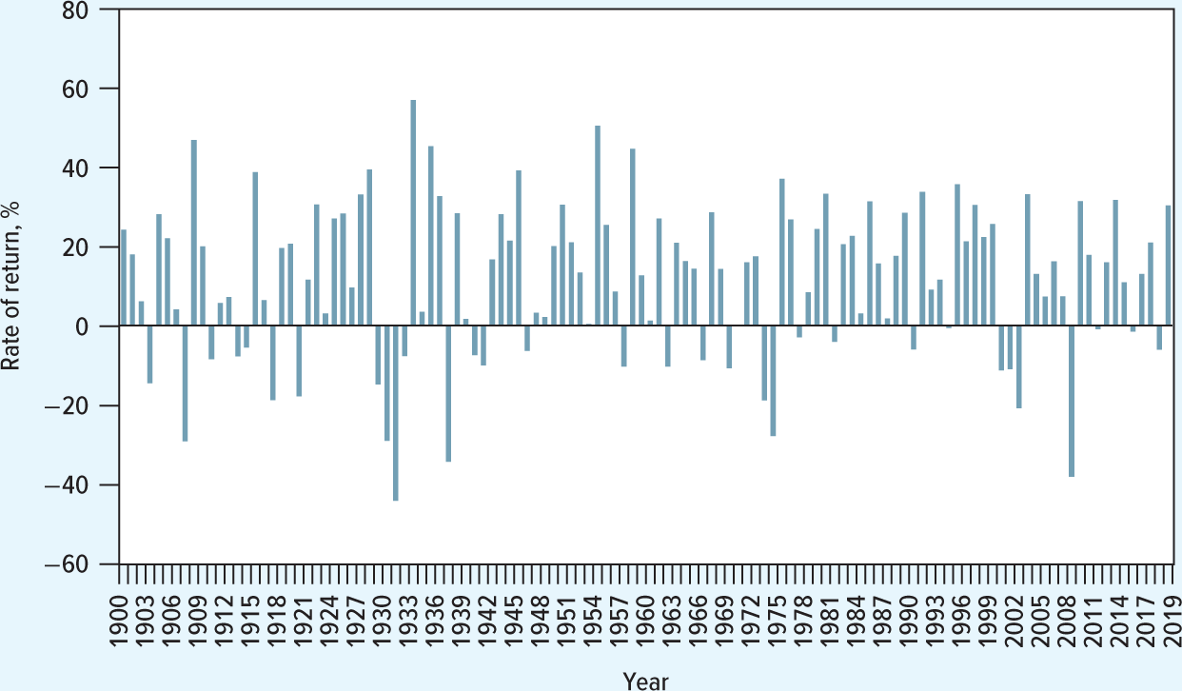
The Stock Market Is a Variable Investment
Stock Market Index Returns.
The stock market has been a profitable but volatile investment.
The x-axis is Years from 1900 to 2019; the y-axis is Rate of return, %. With few exceptions, the rate of return for most years during the period was positive, though year-to-year returns are quite wide. The highest annual return was just over 57% in 1933. However, six years posted losses of more than 25%, the worst being the 43% loss in 1931. Losses also occurred in many years during the 1970s and 2000s.
Source: E. Dimson, P. R. Marsh, and M. Staunton, Triumph of the Optimists: 101 Years of Global Investment Returns (Princeton, NJ: Princeton University Press, 2002), with updates provided by the authors.
7

Slide 8
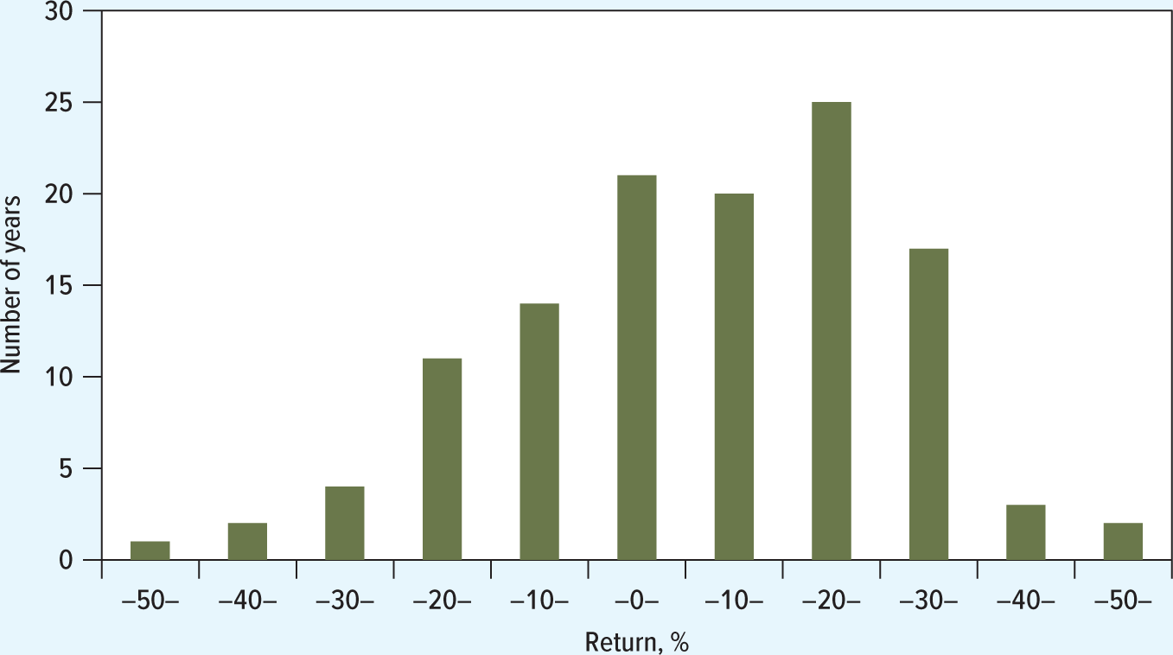
Histogram of the Annual Rates of Return From the Stock Market in the United States
The histogram shows the following approximate results:
Losses of between 40-50 percent: 1 year
Losses of between 30-40 percent: 2 years
Losses of between 20-30 percent: 4 years
Losses of between 10-20 percent: 11 years
Losses of between 0-10 percent: 13 years
Gains of between 1 to 10 percent: 20 years
Gains of between 10 to 20 percent: 18 years
Gains of between 20 to 30 percent: 24 years
Gains of between 30 to 40 percent: 16 years
Gains of between 40 to 50 percent: 3 years
Gains of greater than 50 percent: 2 years
All values are approximated.
1900–2020.
Source: E. Dimson, P. R. Marsh, and M. Staunton, Triumph of the Optimists: 101 Years of Global Investment Returns (Princeton, N J: Princeton University Press, 2002), with updates provided by the authors.
8

Slide 9
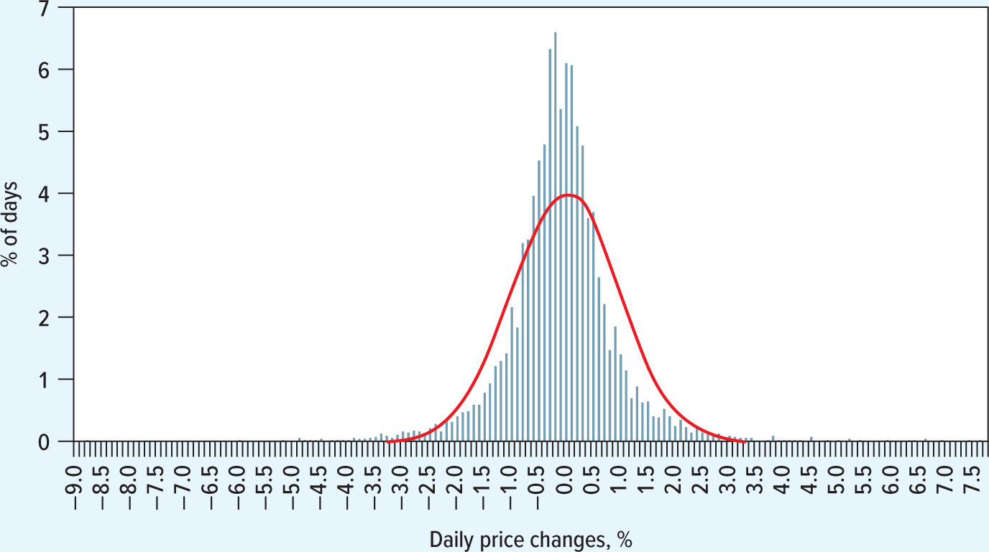
Daily Price Changes for I B M
Price changes versus normal distribution 19 97–2019.
On this histogram, a bell-shaped normal distribution is superimposed.
When measured over short interval, the past returns on any stock conform fairly closely to a normal distribution.
10

Slide 10
How to Measure Risk
Variance.
The expected (or average) value of
A measure of volatility.
Standard Deviation.
The square root of the variance.
A measure of volatility.
9

Slide 11
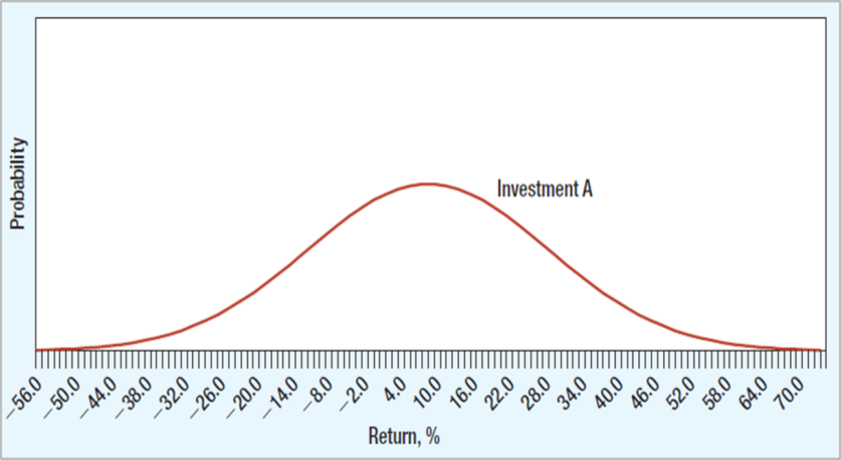
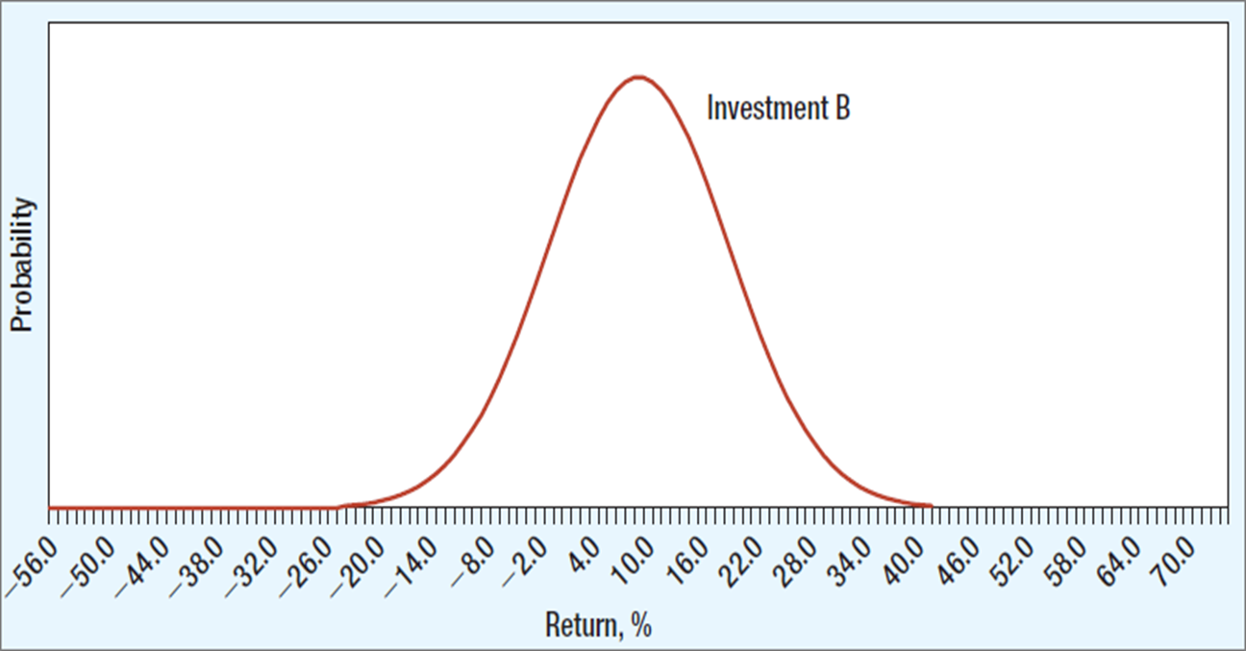
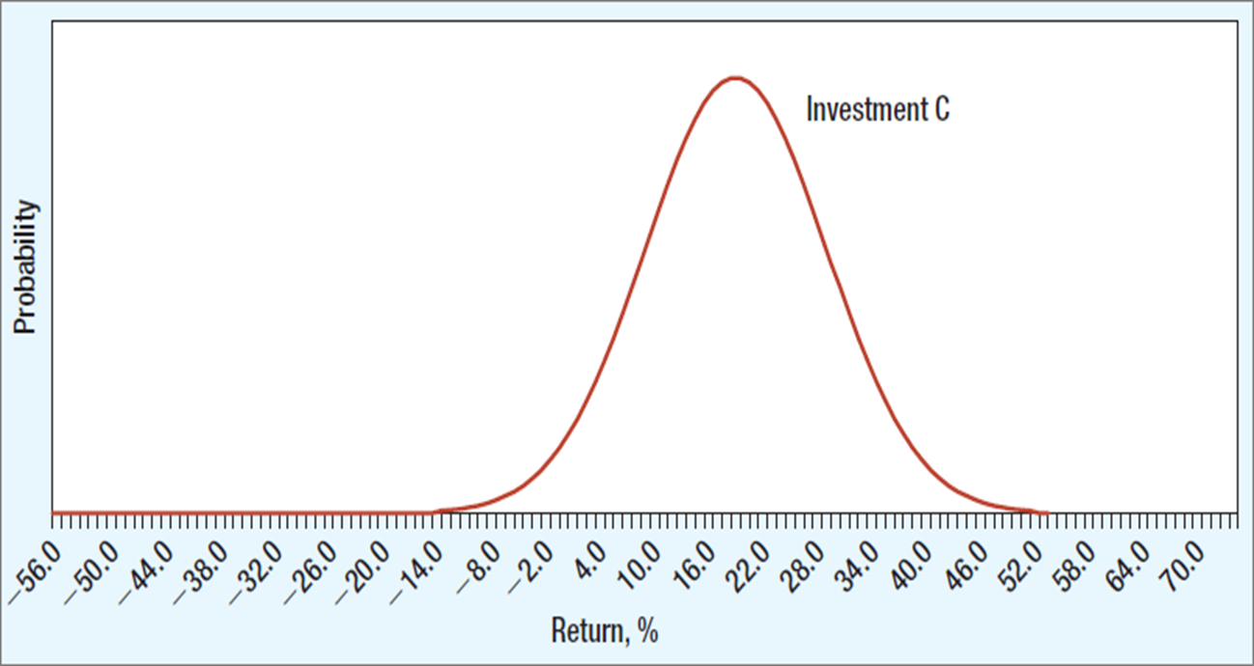
Standard Deviation Versus Expected Return
Investments A and B both have an expected return of 10%, but because investment A has the greater spread of possible returns, it is more risky than B.
We can measure this spread by the standard deviation.
Investment A has a standard deviation of 15%; B, 7.5%.
Most investors would prefer B to A.
Investment B and C both have the same standard deviation, but C offers a higher expected return (20%).
Most investors would prefer C to B.

Slide 12
Standard Deviation and Variance for Different Securities
1900–2020
Portfolio | Standard Deviation (σ) | Variance (σ²)
Treasury bills | 2.8% | 8.1
Government bonds | 8.9 | 79.7
Stocks | 19.5 | 381.8
In the following table, read ' σ² ' as sigma squared.
15

Slide 13
The Coin Tossing Game: Calculating Variance and Standard Deviation
Consider the following game: You start by investing $100. Then two coins are flipped. For each head, you get back your starting balance plus 20%, and for each tail, you get back your starting balance less 10%. So there are 4 equally likely outcomes:
Head + Head: You gain 40%
Head + Tail: You gain 10%
Tail + Head: You gain 10%
Tail + Tail: You lose 20%
(1) Percent Rate of Return r~ | (2) Deviation From Expected Return (r~−r) | (3)Squared Deviation (r~ − r)² | (4) Probability | (5) Probability × Squared Deviation
+40 | +30 | 900 | .25 | 225
+10 | 0 | 0 | .5 | 0
−20 | −30 | 900 | .25 | 225
14

Slide 14
How Diversification Reduces Risk
Standard deviations for selected US common stocks, March 2015 – February 2020
Stock | Standard Deviation | Stock | Standard Deviation
United States Steel | 76.4% | Wells Fargo | 21.6%
Tesla | 48.1% | ExxonMobil | 19.4%
Newmont | 36.7% | Consolidated Edison | 16.5%
Southwest Airlines | 30.5% | Johnson & Johnson | 14.4%
Amazon | 28.3% | Coca-Cola | 12.6%
Market portfolio’s standard deviation was just over 12% during this period.
Standard Deviation
 | Stock | Market |  | Stock | Market
BHP Billiton (Australia) | 26.2% | 10.9% | Sanofi (France) | 17.5% | 14.0%
BP(U.K.) | 22.8% | 11.3% | Nestle (Switzerland) | 13.6% | 10.9%
Siemens (Germany) | 22.5% | 15.5% | Sony (Japan) | 27.6% | 16.4%
Hyundai Heavy Industry (Korea) | 40.7% | 12.5% | Toronto-Dominion Bank (Canada) | 12.0% | 9.1%
Agricultural Bank (China) | 25.5% | 18.5% | Tata Motors (India) | 45.3% | 15.0%
17

Slide 15
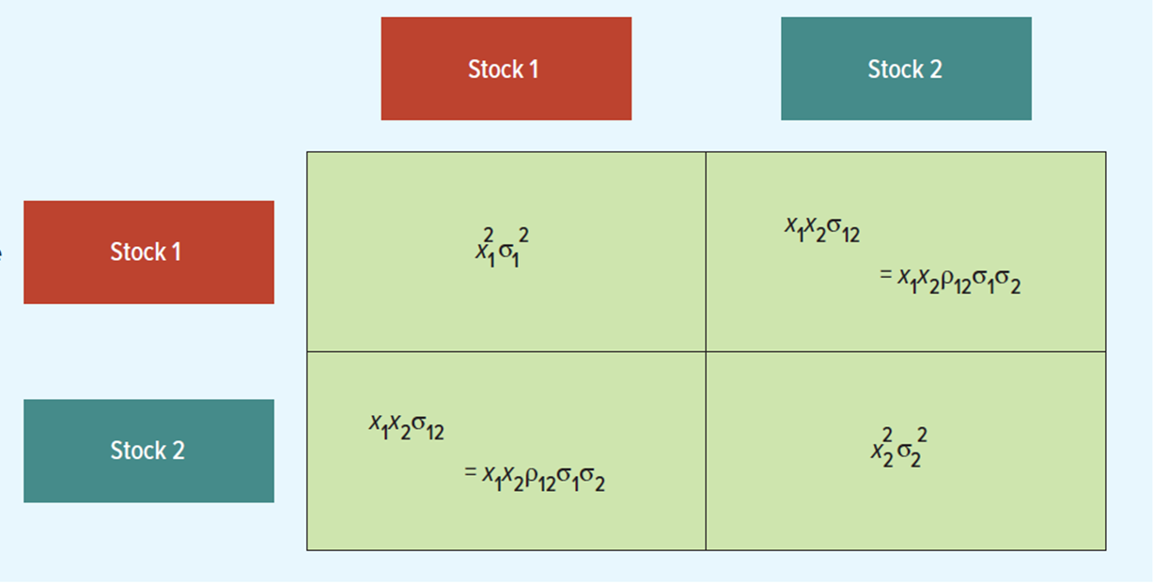
The Variance of a Two-Stock Portfolio Is the Sum of These Four Boxes
18

Slide 16
Portfolio Risk Example 1
Example
Suppose you invest 60% of your portfolio in Southwest Airlines and the remainder in Amazon. The expected dollar return on your Southwest investment is 15.0% and on Amazon is 10.0%. The expected return on your portfolio is:
19

Slide 17
Portfolio Risk Example 2
Example
Suppose you invest 60% of your portfolio in Southwest Airlines and the remainder in Amazon. The expected dollar return on your Southwest investment is 15.0% and on Amazon is 10.0%. The standard deviation of returns was 26.6% for Amazon and 27.9% for Southwest Airlines. Assume a correlation coefficient of 1.0 and calculate the portfolio variance and standard deviation.
20

Slide 18
Portfolio Risk Example 3
Example
Suppose you invest 60% of your portfolio in Southwest Airlines and the remainder in Amazon. The expected dollar return on your Southwest investment is 15.0% and on Amazon is 10.0%. The standard deviation of returns was 26.6% for Amazon and 27.9% for Southwest Airlines. Assume a correlation coefficient of 1.0 and calculate the portfolio variance and standard deviation.
21

Slide 19
Portfolio Risk Example 4
Example
Suppose you invest 60% of your portfolio in Southwest Airlines and the remainder in Amazon. The expected dollar return on your Southwest investment is 15.0% and on Amazon is 10.0%. The standard deviation of returns was 26.6% for Amazon and 27.9% for Southwest Airlines. Assume a correlation coefficient of 0.26 and calculate the portfolio variance and standard deviation.
22

Slide 20
Portfolio Risk Example 5
Another Example
Suppose you invest 60% of your portfolio in Southwest Airlines and the remainder in Amazon. The expected dollar return on your Southwest investment is 15.0% and on Amazon is 10.0%. The standard deviation of returns was 26.6% for Amazon and 27.9% for Southwest Airlines. Assume a correlation coefficient of –1 and calculate the portfolio variance and standard deviation.
23

Slide 21
Portfolio Risk Equations—Two Securities
24

Slide 22
How Diversification Reduces Risk
Diversification: Strategy designed to reduce risk by spreading the portfolio across many investments.
Specific Risk: Risk factors affecting only that firm. Also called “diversifiable risk.” Also known as idiosyncratic risk, residual risk, unique risk, or unsystematic risk.
Market Risk: Economywide sources of risk that affect the overall stock market. Also called “systematic risk.”
17

Slide 23
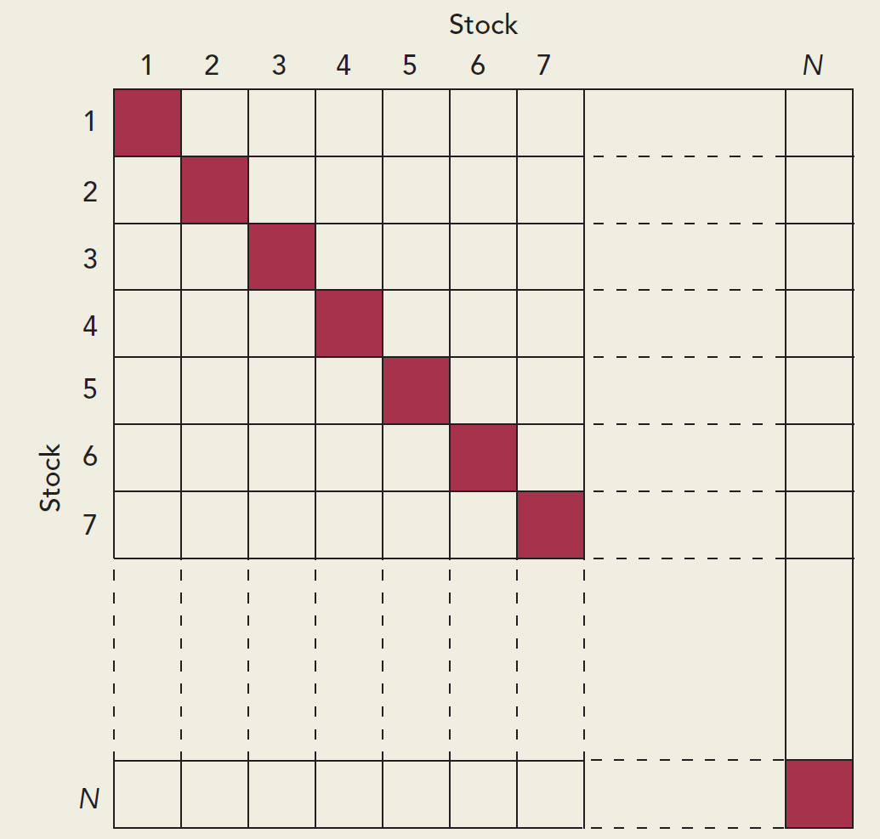
Portfolio Risk Equations—N Securities
To find the variance of an N-stock portfolio, we must add the entries in a matrix like this.
The diagonal cells contain variance terms, and the off-diagonal cells contain covariance terms.
Note: When there are just two securities, there are equal numbers of variance and covariance boxes. When there are many securities, the number of covariances is much larger than the number of variances. Thus, the risk of a well-diversified portfolio reflects mainly the covariances.
25

Slide 24
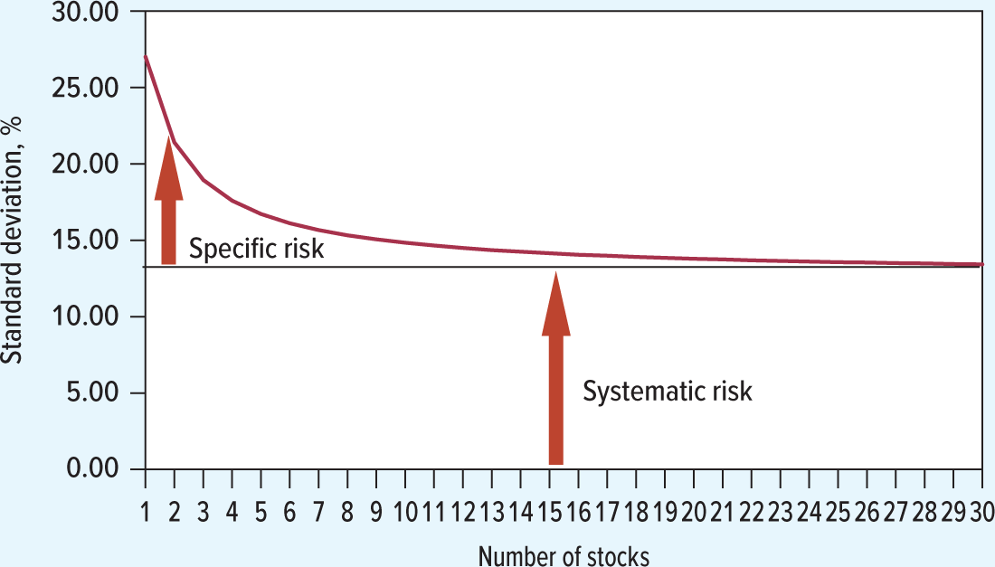
Even Random Diversification Eliminates Specific Risk
Average risk (standard deviation) of portfolios containing different numbers of stocks. The stocks were selected randomly from stocks traded on the New York Stock Exchange from 2010 through 2019. Notice that diversification reduces risk rapidly at first, then more slowly. This is because diversification can only eliminate
specific risk. It cannot eliminate
systematic risk.
Risk that diversification cannot eliminate is market risk, N Y S E, 2010–2019.
26

Slide 25
Harry Markowitz and the Birth of Portfolio Theory
The total risk of an individual company is measured by its standard deviation. If you held that stock in isolation, that’s the amount of risk you’d bear. But investors don’t hold individual stocks. They hold portfolios. The risk that a stock adds to a diversified portfolio isn’t its total risk but only the systematic risk that’s shared with the rest of the portfolio. Specific risk is diversified away.
Combining stocks into portfolios can reduce standard deviation, below the level obtained from a simple weighted average calculation.
Correlation coefficients make this possible.
The various weighted combinations of stocks that create this standard deviation constitute a set of efficient portfolios.
27

Slide 26
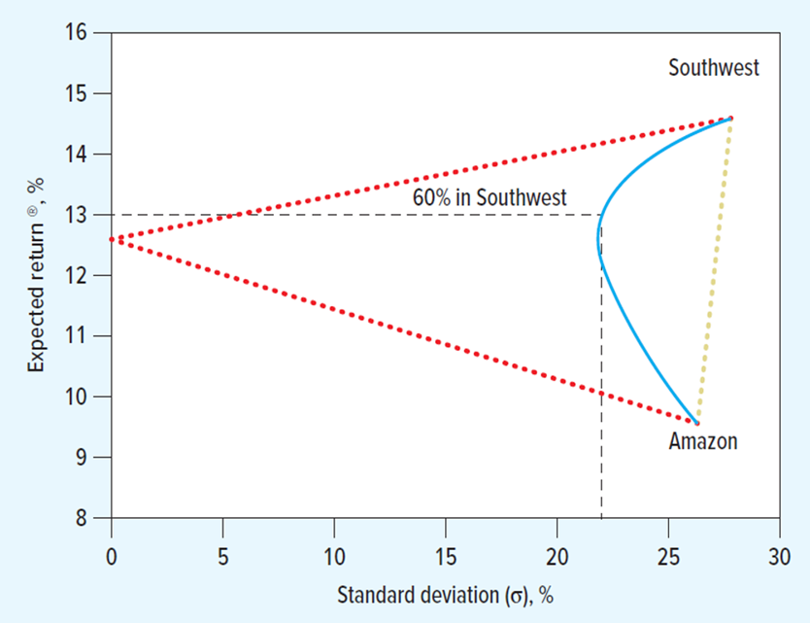
Southwest and Amazon
Recall previous Example
Suppose you invest 60% of your portfolio in Southwest Airlines and the remainder in Amazon. The expected dollar return on your Southwest investment is 15.0% and on Amazon is 10.0%. The standard deviation of returns was 26.6% for Amazon and 27.9% for Southwest Airlines. Assume a correlation coefficient of 0.26 and calculate the portfolio variance and standard deviation.
The blue curve (investment opportunity set) illustrates how expected return and standard deviation change as you hold different combinations of two stocks.
Diversification reduces risk.
28

Slide 27
Examples of Efficient Portfolios Chosen from 10 Stocks
Three Efficient Portfolios—Percentages Allocated to Each Stock (%)
 | Expected Return (%) | Standard Deviation (%) | A | B | T
United States Steel | 6.0 | 76.4 |  | 0 | 0
Tesla | 6.5 | 48.1 |  | 1 | 5
Newmont | 5.0 | 36.7 |  | 7 | 9
Southwest Airlines | 10.0 | 30.5 | 100 | 0 | 17
Amazon | 8.0 | 28.3 |  | 1 | 10
Wells Fargo | 6.8 | 21.6 |  | 21 | 23
ExxonMobil | 5.3 | 19.4 |  | 0 | 0
Consolidated Edison | 5.5 | 16.5 |  | 20 | 33
Johnson & Johnson | 4.4 | 14.4 |  | 7 | 0
Coca-Cola | 4.8 | 12.6 |  | 43 | 5
Expected portfolio return |  |  | 10.0 | 5.4 | 6.8
Portfolio standard deviation |  |  | 30.5 | 10.5 | 12.5
Note: Standard deviations and the correlations between stock returns were estimated from monthly returns, March 2015–February 2020. Efficient portfolios are calculated assuming that short sales are prohibited.
29

Slide 28
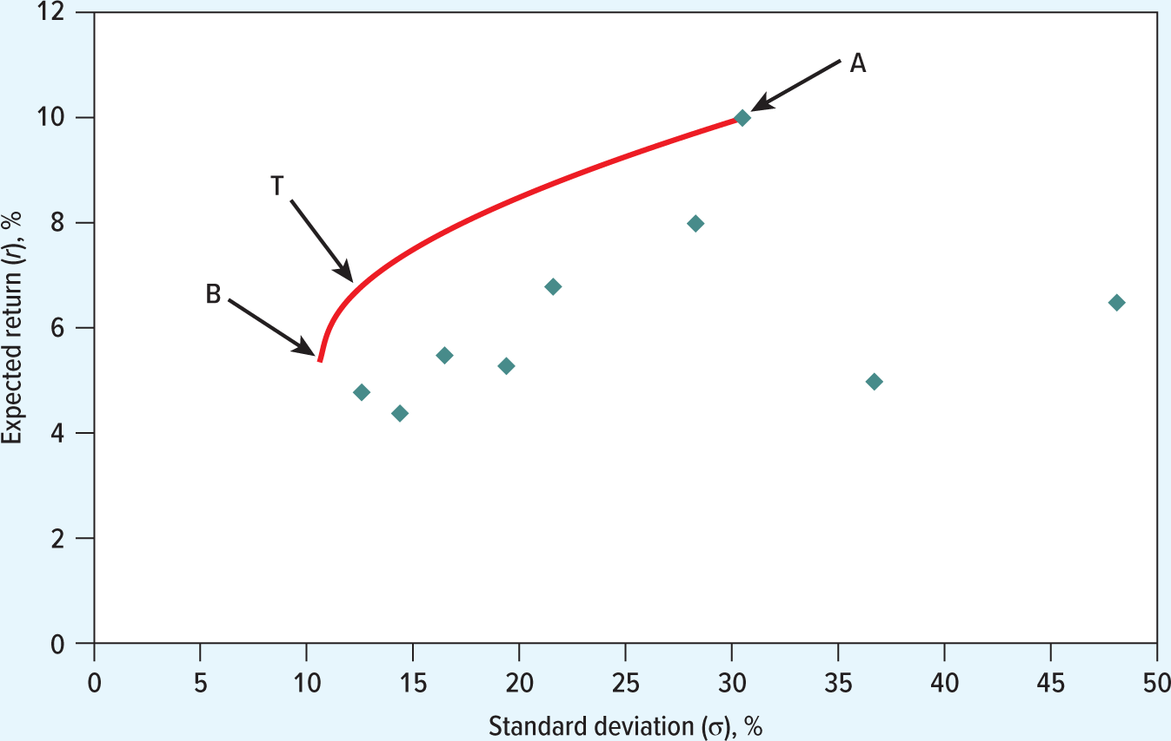
Efficient Portfolios
Each dot shows the expected return and standard deviation of stocks. These are efficient portfolios, denoted with A, B, and C.
Each dot shows the expected return and standard deviation of stocks. There are many possible combinations of expected return and standard deviation from investing in a mixture of these stocks. If you like high expected returns and dislike high standard deviations, you will prefer portfolios along the red line. These are efficient portfolios. The red curve is called efficient frontier.
30

Slide 29
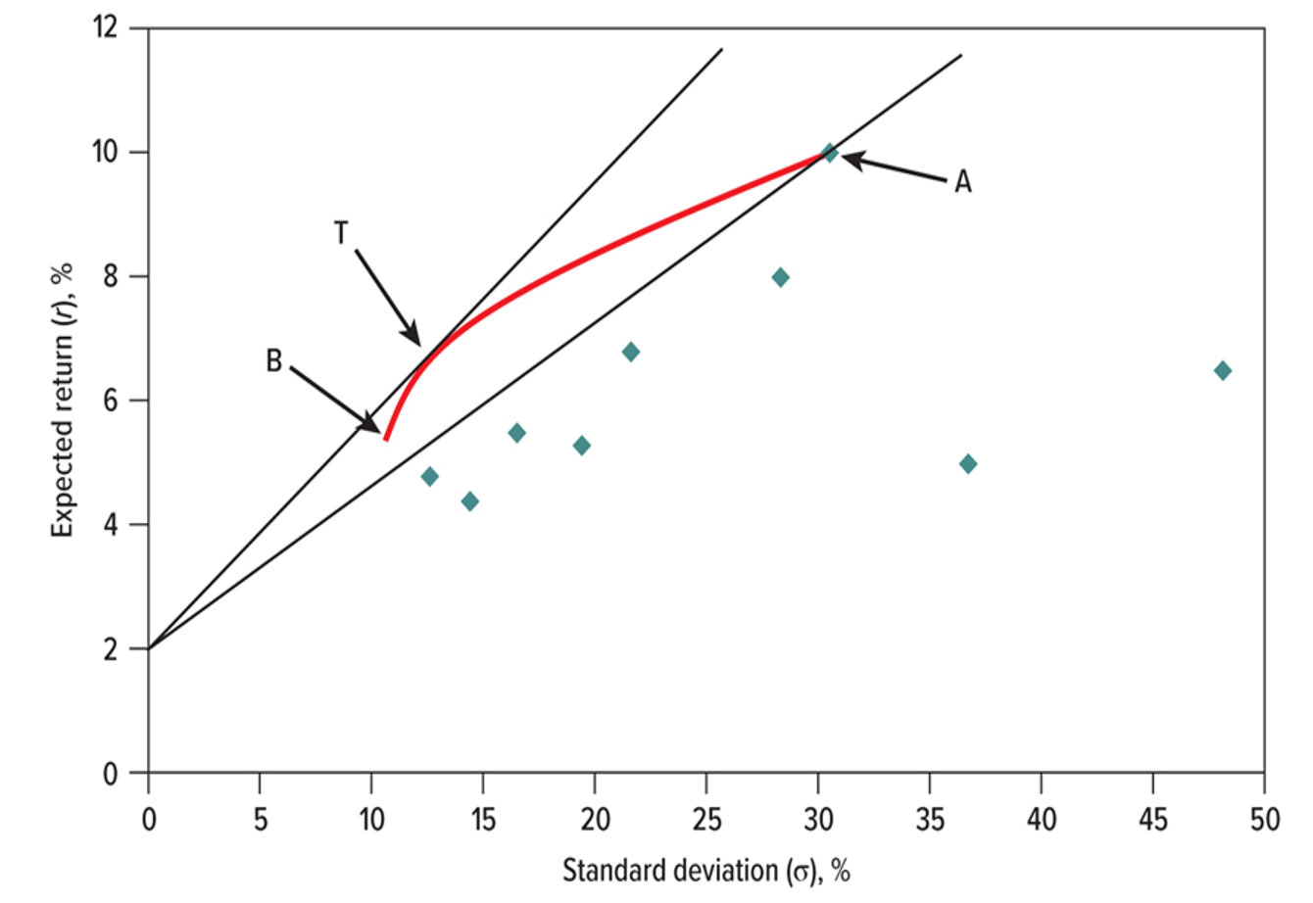
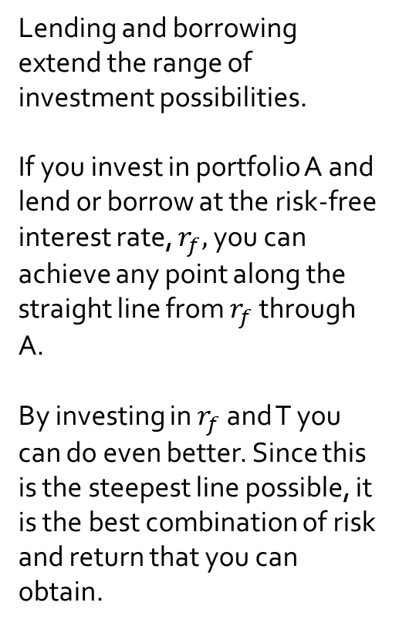
Lending and Borrowing
Lending and borrowing extend the range of investment possibilities.
If you invest in portfolio A and lend or borrow at the risk-free interest rate, $r_{f},$ you can achieve any point along the straight line from $r_{f}$ through A.
By investing in $r_{f}$ and T you can do even better. Since this is the steepest line possible, it is the best combination of risk and return that you can obtain.
31

Slide 30
Sharpe Ratio
By moving money from Treasury bills into the risky portfolio, you can increase your risk, but also your expected return.
The slope of the straight line shows how much money you earn from each dollar invested – how much your expected return rises when your risk goes up by 1%. This slope is known as the Sharpe ratio.
The ratio of the risk premium to the standard deviation is called the Sharpe ratio.
32

Slide 31
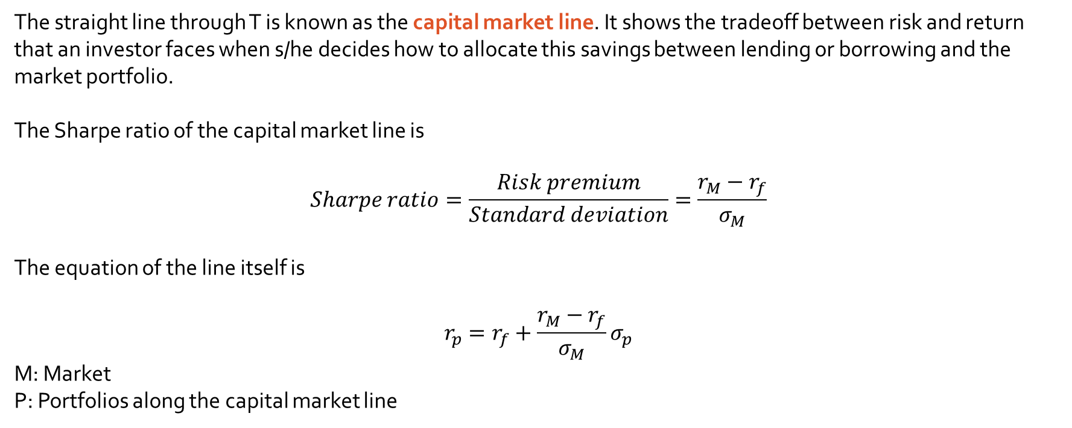
Lending and Borrowing
Lending or borrowing at the risk-free rate (r_{f}) allows us to exist outside the efficient frontier.
The straight line through T is known as the capital market line. It shows the tradeoff between risk and return that an investor faces when s/he decides how to allocate this savings between lending or borrowing and the market portfolio.
The Sharpe ratio of the capital market line is
$$Sharpe ratio=\frac{Risk premium}{Standard deviation}=\frac{r_{M}−r_{f}}{σ_{M}}$$
The equation of the line itself is
$$r_{p}=r_{f}+\frac{r_{M}−r_{f}}{σ_{M}}σ_{p}$$
M: Market
P: Portfolios along the capital market line
31

